Slide 1


An introduction to Open Source MANO project (OSM)
Gerardo García, Telefónica
Lakshmi Sharma, Rift.io
Artur Tyloch, Canonical
Anil Gunturu, RIFT.io
osm.etsi.org

Slide 2


Problem Statement
INDUSTRY FRAGMENTATION IN MANO SPACE
SPEED IS CRITICAL

Slide 3
Why OSM?
3 reasons that make the difference

Slide 4


























1) Open Source Initiative hosted by ETSI, easing alignment with NFV ISG…
…driven by service provider requirements
… and supported by key players of the virtualization space
… OPEN TO NEW FELLOW TRAVELLERS

Slide 5
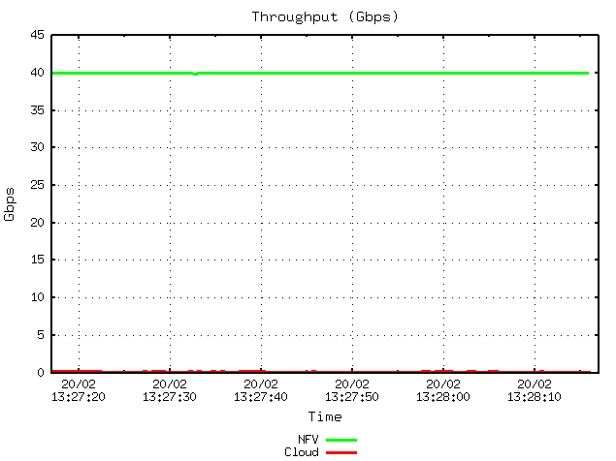

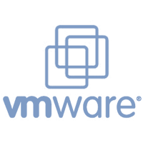



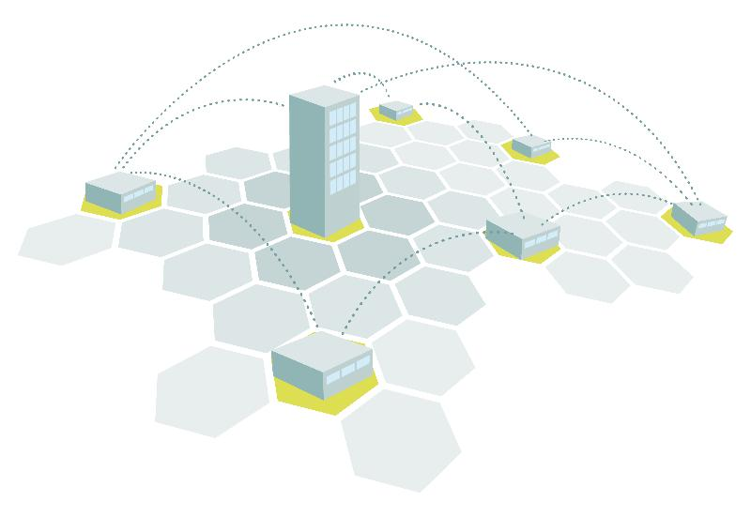
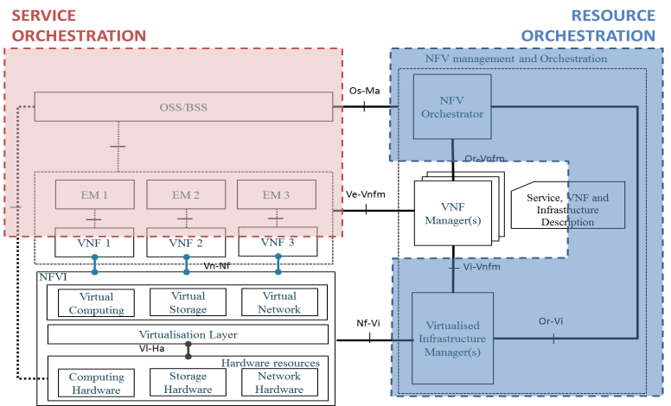
2) It embraces the complexity required
for deployments in field
1. EPA support
2. Multi-VIM
x100
3. Multi-site
4. SO and RO can be detached

Slide 6



3) We are not starting from scratch
The project starts with running code from the beginning…
OpenMANO (RO)
Juju Charms (VNF Modeling & Config)
Launchpad (SO/NS management)
… which helps to:
Avoid over-engineering due to excess of abstraction
Start getting traction at SP level
Ecosystem steering
Seed code represents an initial starting point, being all components pluggable/replaceable for OSM

Slide 7
3) We are not starting from scratch
15th Oct 15
Dusseldorf SDN NFV World Congress
28th Jan 16
1st F2F integration meeting towards MWC’16
22nd Feb 2016
MWC 16
Project presentation and press release
4th Apr 16
Kick-off and 1ST Design meeting
27th Oct 15
ETSI NFV #12
@Jersey City
18th Feb 16
ETSI NFV #13
@Dublin

Slide 8
Scope of OSM

Slide 9
Real operation is multi-layered by nature
 | NETWORK CREATION | FULFILLMENT | ASSURANCE
(L3) SERVICE OPERATION (e.g. chaining of VAS & self-care portal) |  | Add users to VPN Add and chain VAS to VPN (self-care) | QoE monitoring
(L2) SERVICE MANAGER (e.g. VPN service) | VPN service design | VPN deployment | VPN service monitoring
(L1) NETWORK DEPARTMENT (e.g network core) | Network scenario creation & deployment (PE per site) | Network scenario provisioning | Network scenario monitoring
(L0) NFVI OPERATOR | Installation of switches & servers | Tenant creation. Allocation of tenant quotes. | Monitoring of usage of resources by tenants. Monitoring of NFVI infrastructure

Slide 10
Current MANO approaches are partial
 | NETWORK CREATION | FULFILLMENT | ASSURANCE
(L3) SERVICE OPERATION (e.g. chaining of VAS & self-care portal) |  | Add users to VPN Add and chain VAS to VPN (self-care) | QoE monitoring
(L2) SERVICE MANAGER (e.g. VPN service) | VPN service design | VPN deployment | VPN service monitoring
(L1) NETWORK DEPARTMENT (e.g network core) | Network scenario creation & deployment (PE per site) | Network scenario provisioning | Network scenario monitoring
(L0) NFVI OPERATOR | Installation of switches & servers | Tenant creation. Allocation of tenant quotes. | Monitoring of usage of resources by tenants. Monitoring of NFVI infrastructure
SCOPE OF CURRENT MANO APPROACHES
STATIC / TRADITIONAL OPERATION
CLOUD OPERATION

Slide 11
Current MANO approaches are partial
 | NETWORK CREATION | FULFILLMENT | ASSURANCE
(L3) SERVICE OPERATION (e.g. chaining of VAS & self-care portal) |  | Add users to VPN Add and chain VAS to VPN (self-care) | QoE monitoring
(L2) SERVICE MANAGER (e.g. VPN service) | VPN service design | VPN deployment | VPN service monitoring
(L1) NETWORK DEPARTMENT (e.g network core) | Network scenario creation & deployment (PE per site) | Network scenario provisioning | Network scenario monitoring
(L0) NFVI OPERATOR | Installation of switches & servers | Tenant creation. Allocation of tenant quotes. | Monitoring of usage of resources by tenants. Monitoring of NFVI infrastructure
STATIC / TRADITIONAL OPERATION
SCOPE OF CURRENT MANO APPROACHES
STATIC / TRADITIONAL OPERATION
CLOUD OPERATION

Slide 12
Real operation is multi-layered by nature, so MANO needs to embrace it to have real operational impact
 | NETWORK CREATION | FULFILLMENT | ASSURANCE
(L3) SERVICE OPERATION (e.g. chaining of VAS & self-care portal) |  | Add users to VPN Add and chain VAS to VPN (self-care) | QoE monitoring
(L2) SERVICE MANAGER (e.g. VPN service) | VPN service design | VPN deployment | VPN service monitoring
(L1) NETWORK DEPARTMENT (e.g network core) | Network scenario creation & deployment (PE per site) | Network scenario provisioning | Network scenario monitoring
(L0) NFVI OPERATOR | Installation of switches & servers | Tenant creation. Allocation of tenant quotes. | Monitoring of usage of resources by tenants. Monitoring of NFVI infrastructure
SCOPE OF OSM
CLOUD OPERATION

Slide 13
PROJECT SCOPE & AREAS
COMMUNITY-DRIVEN IMPLEMENTATION OF
NFVO+VNFM+SO*
1
NFV management and Orchestration
Os-Ma
NFV Orchestrator
Or-Vi
OSS/BSS
Or-Vnfm
DESCRIPTORS
(VNFD & NSD)
EM(s)
Specific VNF-M(s)
Ve-Vnfm
2
Generic VNF Manager
VNF 1
VNF 2
VNF 3
Service, VNF and Infrastructure Description
Vn-Nf
Vi-Vnfm
NFVI
Virtual Computing
Virtual Storage
Virtual Network
Virtualised
Infrastructure
Manager(s)
Nf-Vi
3
INTEROP & EPA SUPPORT W/REFERENCE VIM(s)
Virtualisation Layer
Vl-Ha
Hardware resources
Computing
Hardware
Storage
Hardware
Network
Hardware
(*) Note: Service Orchestrator (SO) is currently beyond ETSI scope for MANO

Slide 14

Mapping to ETSI NFV
SO
OSM
scope
ETSI NFV
scope
NFVO
ETSI NFV
scope
G-VNFM
S-VNFM
G-VNFM = Generic VNFM
S-VNFM = Specific VNFM (external)

Slide 15
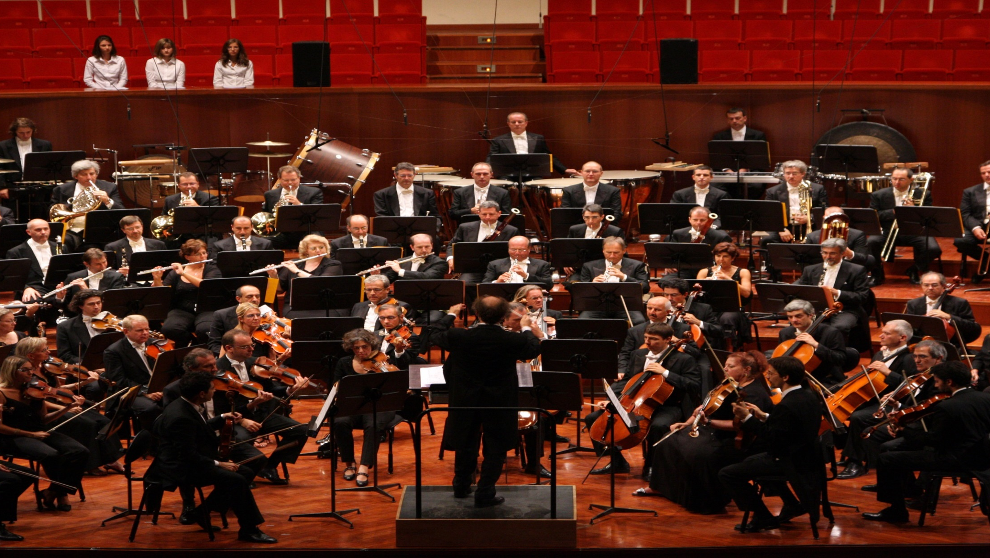
Information Model (IM) is key to enable an open ecosystem of VNF providers and build a coherent E2E service orchestration

Slide 16
Information Model (IM) is key to enable an open ecosystem of VNF providers and build a coherent E2E service orchestration
IM
IM
IM
IM
IM
IM
IM
IM
IM
IM
IM
IM
IM
IM
IM
IM
IM
IM
IM
IM
IM
IM
IM
IM
IM
IM
IM
IM
IM
IM
IM
IM
IM
IM
IM
IM

Slide 17
Common and Standardized INFORMATION MODEL
Delivering an open source MANO stack aligned to ETSI NFV Information Models
Capable of consuming published Information Models (IM) for NFV service and deployment (VNFD, NSD, etc.)
Extending the IM, and recommending back to ETSI NFV
Assuring predictable behaviour of Virtualized Network Functions (VNF) and Network Services (NS) under said information models
Enabling an eco-system of IM-compliant VNF vendors
Ready to be offered to cloud and service providers
No need of integration per- customer & MANO vendor basis

Slide 18



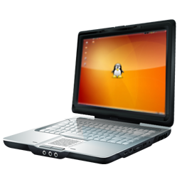
… providing a friendly environment for developers, minimizing entry barriers & paving the way for DevOps
LOCAL DEVELOPMENT &TESTING
TEST POOL FOR DEVELOPERS
SERVICE PROVIDER
Descriptors
Descriptors
VM images
VM images
Open Development Env
Functional tests
Low cost
Integration from the beginning
Real servers and switches
Performance tests (EPA can be enforced)
Cost-effective shared infrastructure
Move the value to VNF services
Production/pre-production environment
Real network scenarios
Final service configuration
Fast deployment
Low final integration cost
SAME DESCRIPTORS ACROSS ALL THE CHAIN!

Slide 19






Demonstration: L3 VPN service with value added services
Putting OSM in practice

Slide 20
MWC 2016 Demo - Rationale
OBJECTIVE: Demonstrate the feasibility of the concepts, starting with existing code seeds
As realistic as possible, with commercial VNFs
Proof of main concepts of OSM:
E2E automation
EPA & underlay control – SLA can be guaranteed
Multi-Site
Multi-VIM
Combination of multi-tenant and single-tenant VNFs
Connection to external physical lines
Useful for next stages of the project
Enabler for further code development
Room for further evolution/complexity

Slide 21
MWC 2016 Demo - OSM integration
OpenStack
OpenStack
Controller
Launchpad
(NSO)
OpenMANO
(RO)
VNF
Compute Node
VNF
Compute Node
VNF
Compute Node
JUJU Server
(CM)
OpenVIM
Proxy
Charm
Proxy
Charm
OpenVIM
Controller
VNF
Compute Node
VNF
Compute Node
VNF
Compute Node

Slide 22







MWC 2016 Use case
mwc
Generator
mgmt
mwc
mgmt
mgmt
mgmt
Corp. SP
10.0.2.0/24
Corp. SP
10.0.1.0/24
mgmt
mwc
VLAN 3000
PE 1
PE 2
VLAN 3000
mwc16data1
mwc16data2
mwc
mwc
VLAN Y
VLAN X
Corp. A
10.0.2.0/24
SSL VPN 2
SSL VPN 1
Corp. A
10.0.1.0/24
PE 3
mgmt
mgmt
mgmt
VIM 1
interDC
VIM 2
VLAN Z
Multi-tenant VNF
Corp. A
10.0.4.0/24
Single-tenant VNF
IMS-corpA
net-mgmtOS
VIM tenant
L2 connection for dataplane
(domain, users)
L2 connection for low BW

Slide 23
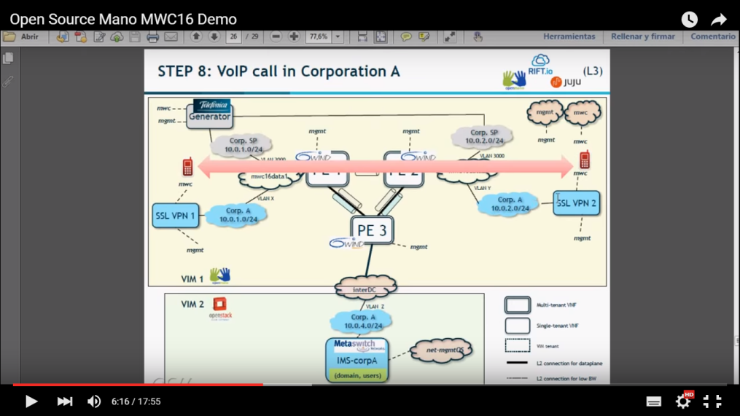
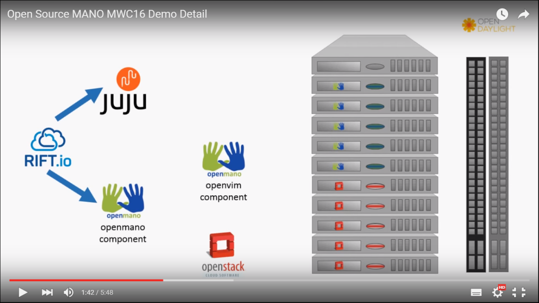
MWC 2016 Demo - Videos
MWC16 demo
Demo infrastructure and interaction of OSM components

Slide 24
Lessons learnt
TEAM WORK
Determination to solve any problem together
RESILIENCE
Ability to withstand bumps along the way
NOT ALL IDEAS SURVIVE
Strategy is quickly drop ‘NOT to do’ items

Slide 25
OSM community

Slide 26
COMMUNITY CHARACTERISTICS
OPEN COMMUNITY-BASED MANO STACK, based on these principles:
Compliance and Feedback to ETSI ISG Architecture and Specs
Base implementation information model Evolution
Independent IOP labs to test & integrate in the community
With an open governance model based on technical meritocracy
TYPES OF ENGAGEMENT
Developers (of course!)
Early adopters
Testers (modules & IOP)
Advisors
END USER ADVISORY GROUP
Service providers and other end users of the technology (not integrators or resellers) will become members
Produce Feature requests to the technical groups

Slide 27

OSM code availability
Code will be available in OSM web page from the kick-off. Meanwhile:
OpenMANO: https://github.com/nfvlabs/openmano
Juju charms and bundles: https://jujucharms.com
RIFTware: https://github.com/RIFTIO/RIFT.ware

Slide 28
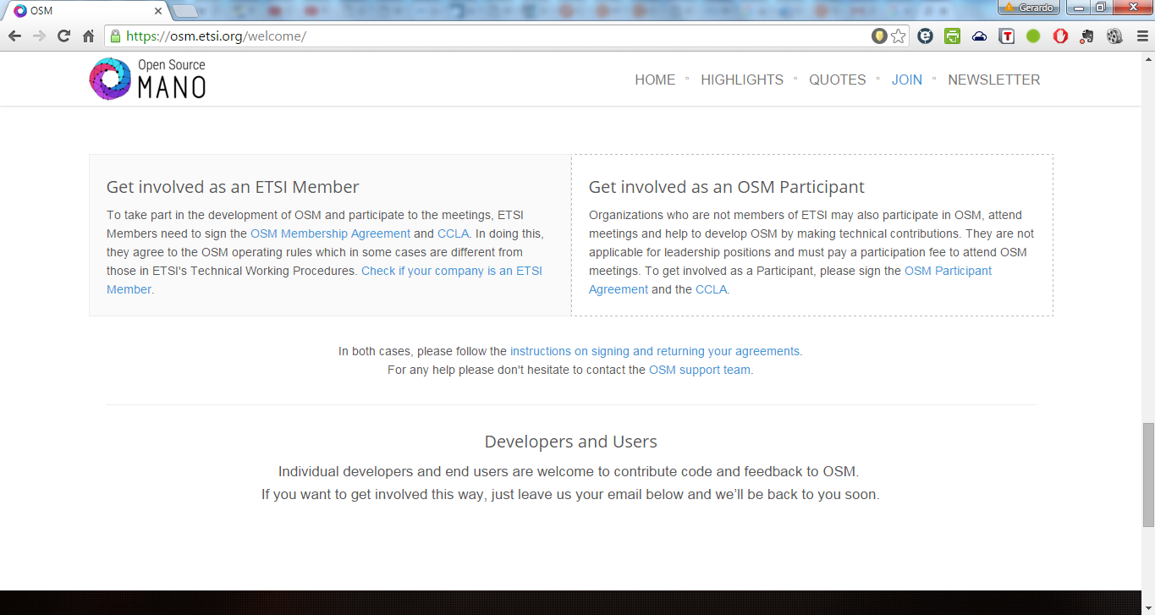
Engage in OSM
osm.etsi.org

Slide 29

Find out more at:
osm.etsi.org

Slide 30
Example of sequence diagram
RIFT.ware
Launchpad
Telefonica
OpenMANO
Canonical
Juju
VNF
1. Instantiate NS
2. Instantiation Complete (resource information)
VNF
Configuration
(Repeat for each VNF)
3. Deploy Proxy Charm
VNF
Configuration
(Repeat for each VNF)
4. Apply Initial Config Primitives
5.Apply Configuration

